Slide 1
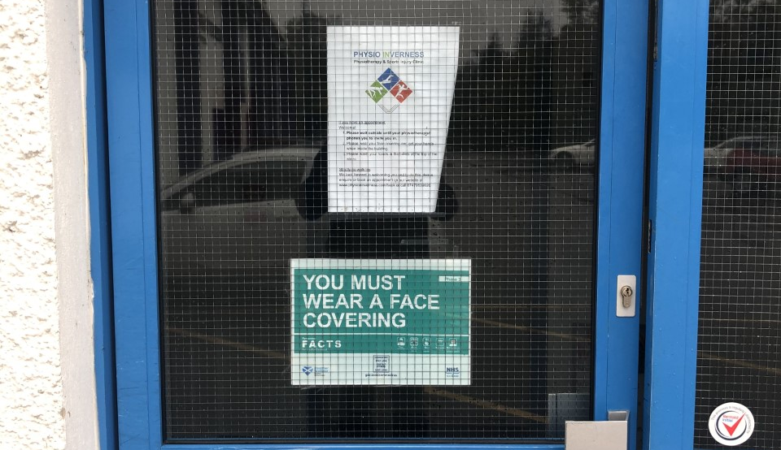

Return to
Ice Hockey In Inverness
Covid-19 Return to Play instruction
Firstly if you are showing Symptoms or have been in contact with someone showing symptoms or that is self isolating following a positive test, Please do not attend the Ice Arena
We are now entering Phase 3 allowing us to return to the Ice, A lot of work at the Ice Centre by the Staff has allowed us to reopen when other rinks have kept their doors closed.
Let's not take this for granted and please follow all the instructions at the Ice Centre so we can all stay on the Ice longterm!

Slide 2
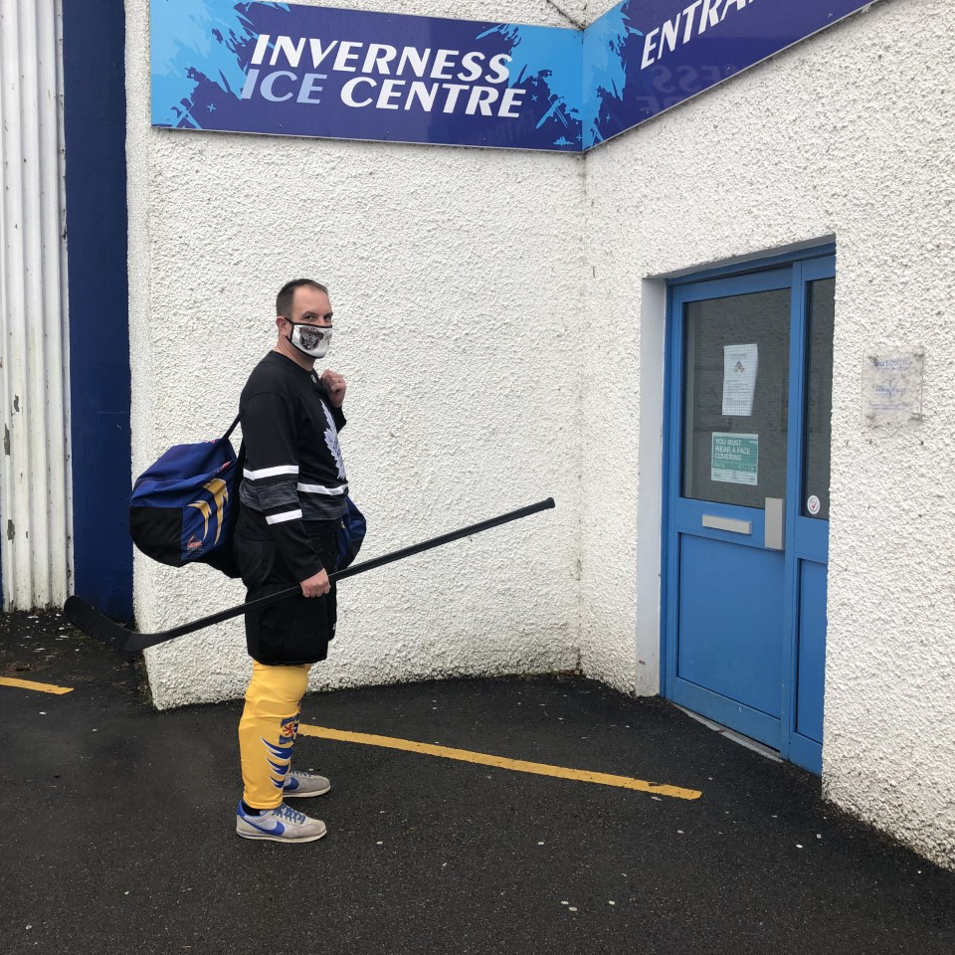
Arrival at the Rink
Please arrive as SIHA instructions with your kit on to the point of just requiring to put your skates, helmet & Gloves on rink side.
Masks must be worn from entering the Ice Rink Building failure to comply will lead to exclusion from future training sessions

Slide 3
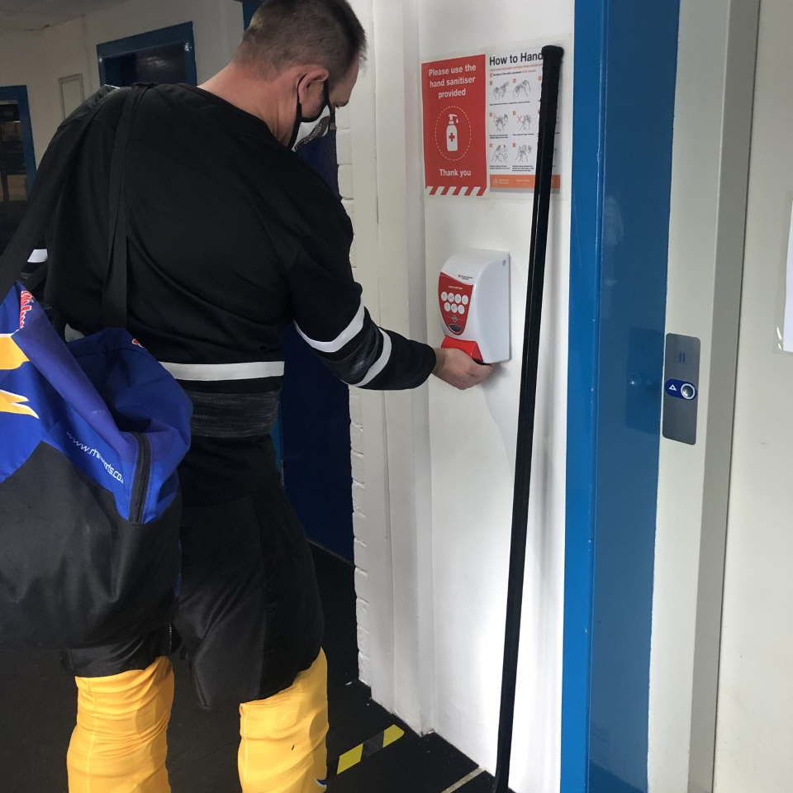
Entering the Ice Centre Building
Please Sanitize your hands using the sanitizing station at the entrance, further Stations are spaced around the rink for use.
Please adhere to all Ice Rink Signed Instructions they are for all the Users and Staffs safety!

Slide 4
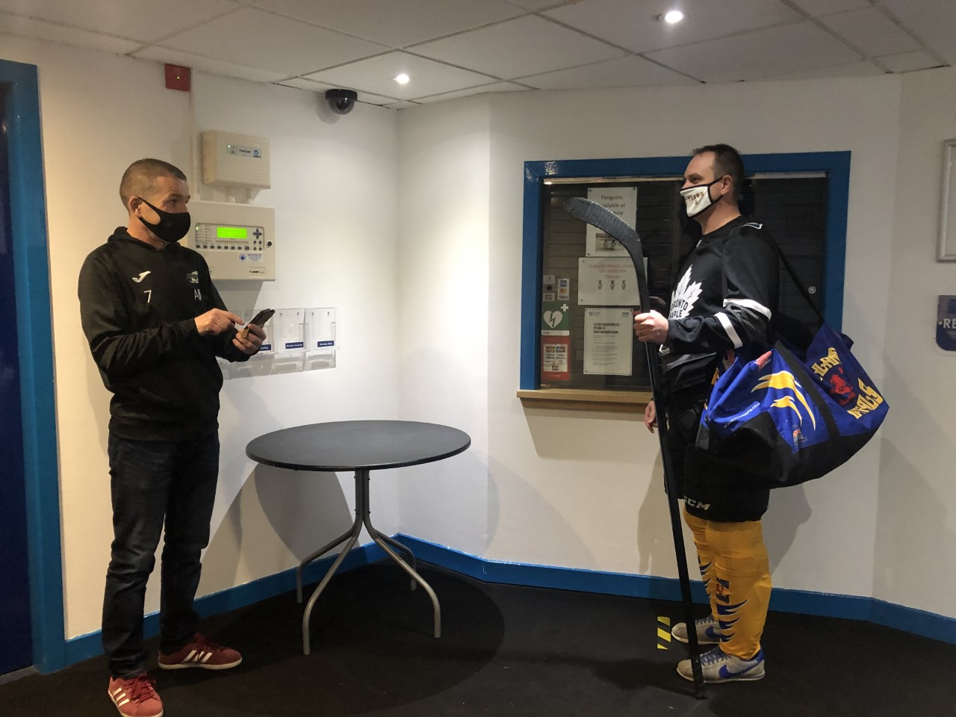
Track and Trace
On arrival you will be met by your Clubs Covid-19 Officer who will track and trace players taking part in each session
Players can not Cross train in sessions and must remain with in their training Group Bubble
You will then be directed to your seating area rink side please follow the instructions given!

Slide 5
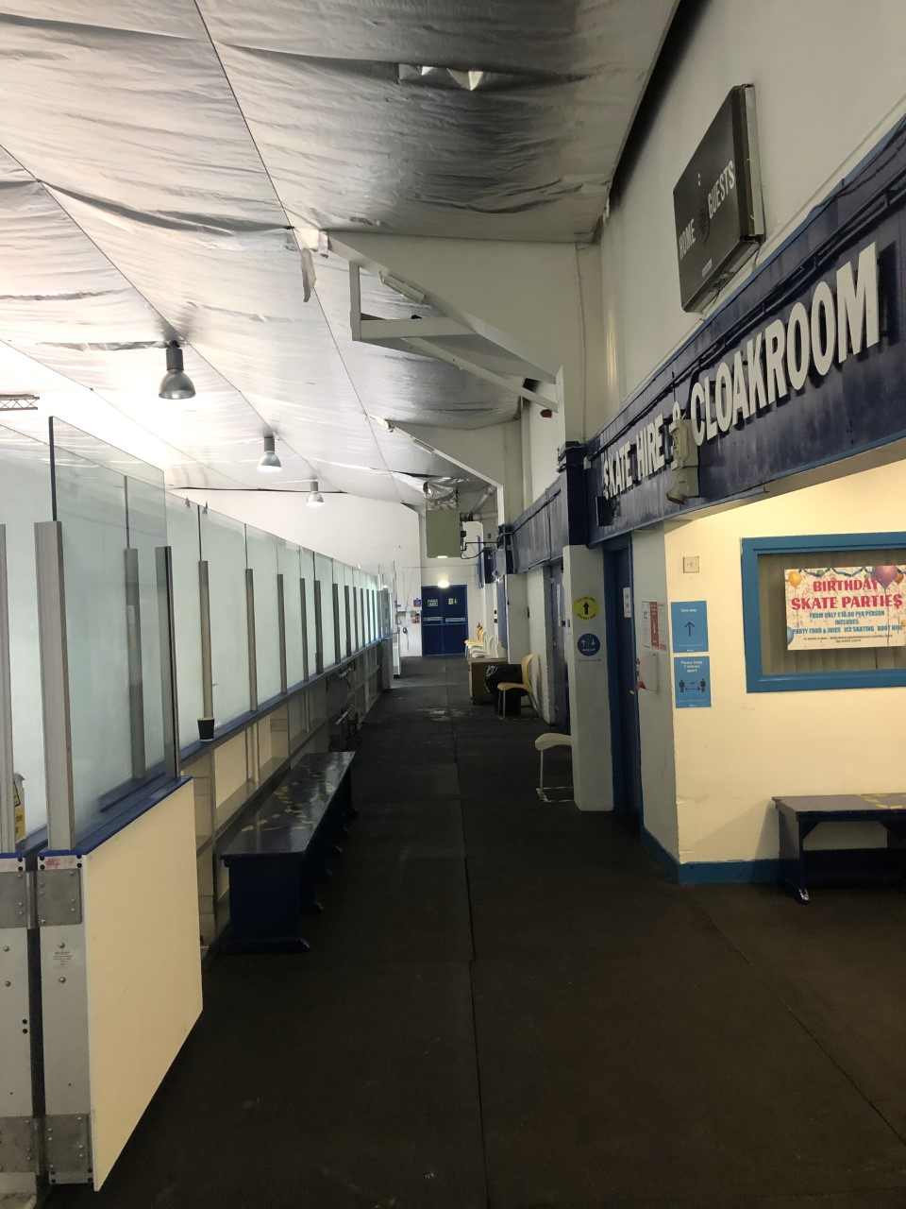
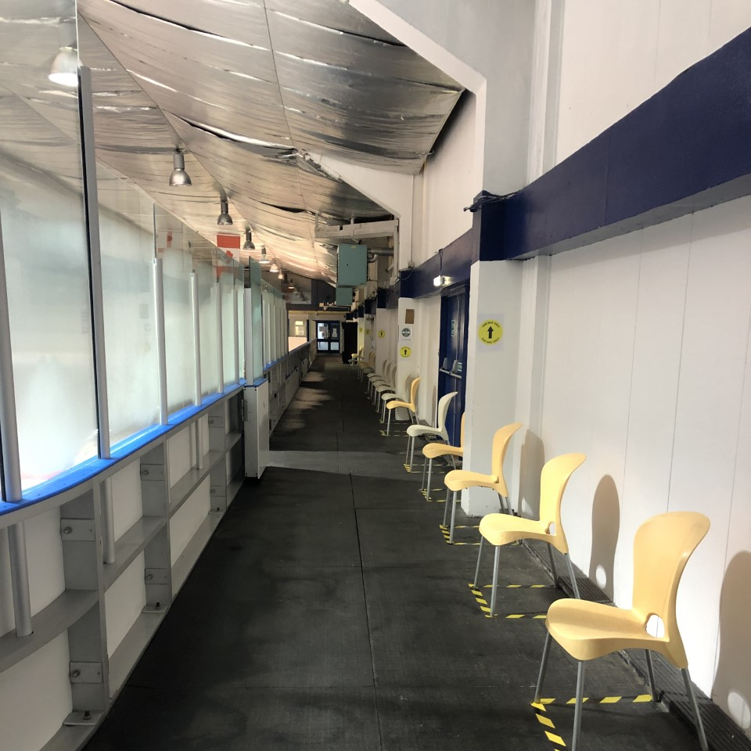
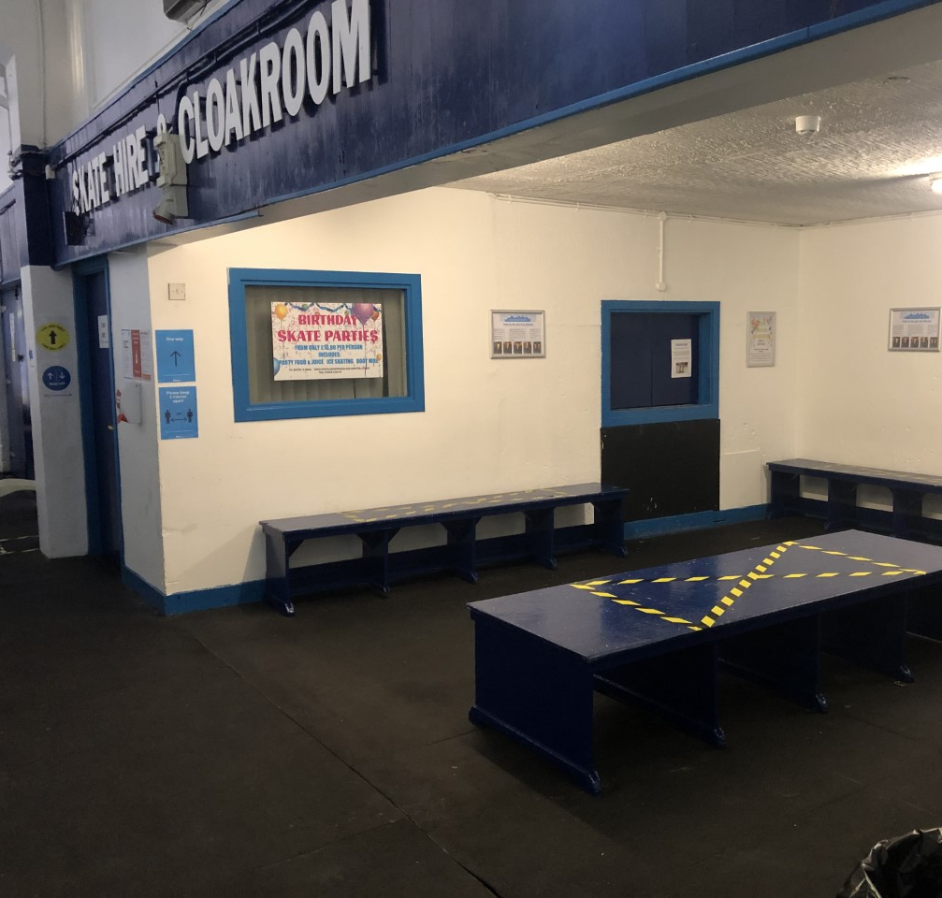
Entering the Ice Hall
Please always follow the instructions, using the one-way systems keeping left as you travel to your allocated seating areas
Please always adhere to Social distancing as sign posted around the rink
Everyone must do their part to keep us all back on the Ice!
No exceptions will be made!
Players ignoring the instruction will be excluded from future training sessions

Slide 6
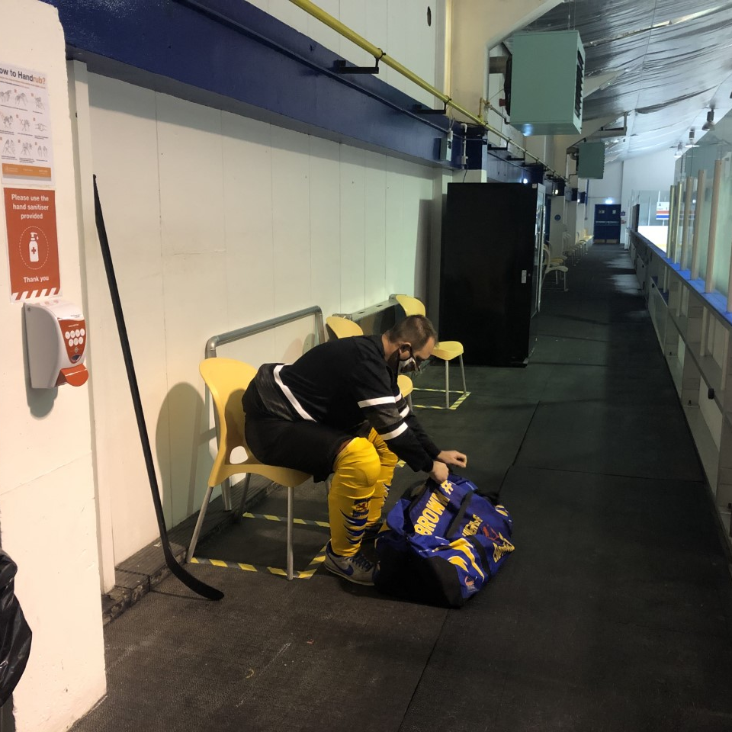
Changing and Kit
When directed to your seat to change you are still required to wear your mask and please do not swap seats!
leaving your Kit bag neatly to the side of your chair to not block the walkways keeping clear at all times
Please take your own prefilled water bottles, do not handle or drink from your teammates!
When you are ready to enter the Ice you can now remove your mask!

Slide 7
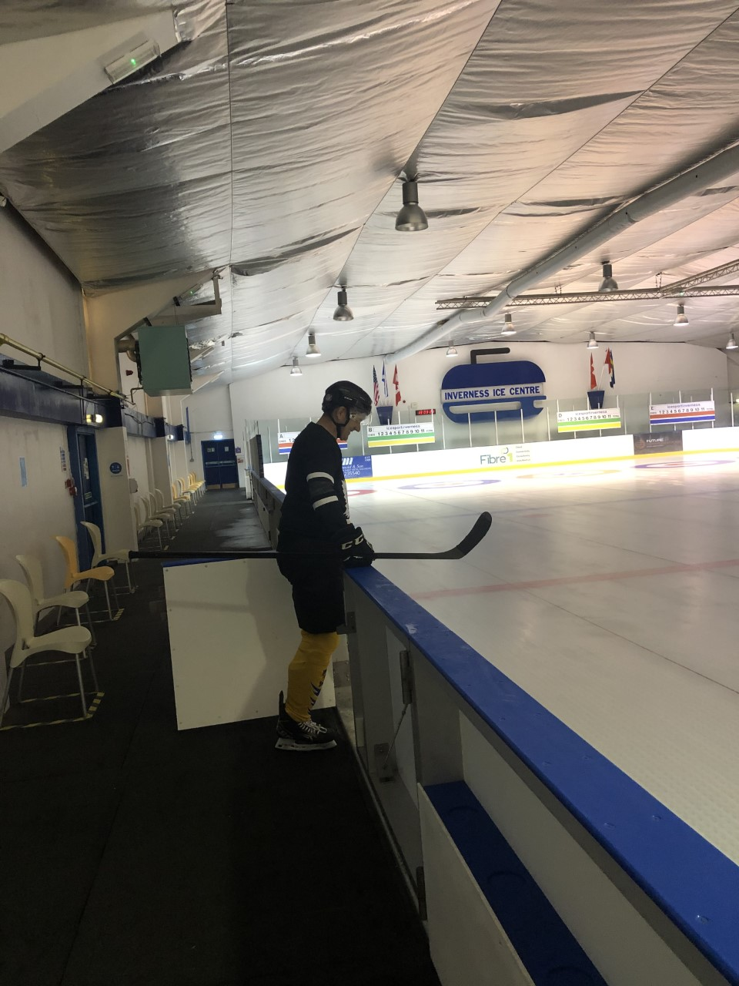
Finally Entering the Ice Pad
Please Only use allocated Exit for Entering and Leaving the Ice
Do not remove Gloves or touch Pucks with Bare Hands
Do not swap sticks or have a go of your teammates new one!
If you require the Toilet, use the allocated Gate and follow the one-way system keeping left.
Wash your hands and Sanitize before re-entering the Ice pad.

Slide 8
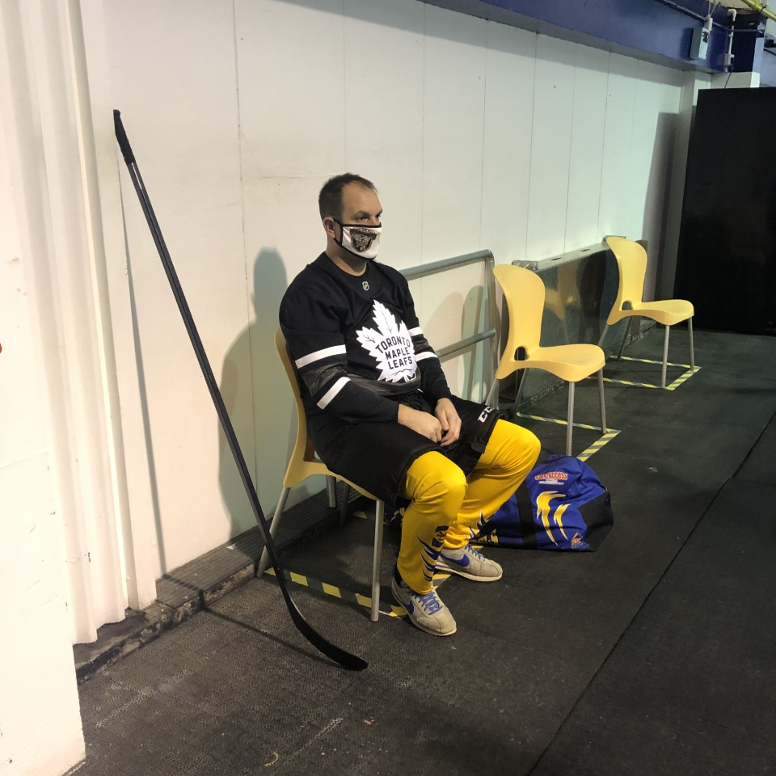
Changing after your session
Please Put your mask back on to protect your teammates rink side
Remove skates, helmet & Gloves!
Don’t be hanging around to Gossip, please change quickly!
To allow speedy turnarounds with the cleaning required between User Groups!
Don’t be too Sad like Jamie its all over!

Slide 9
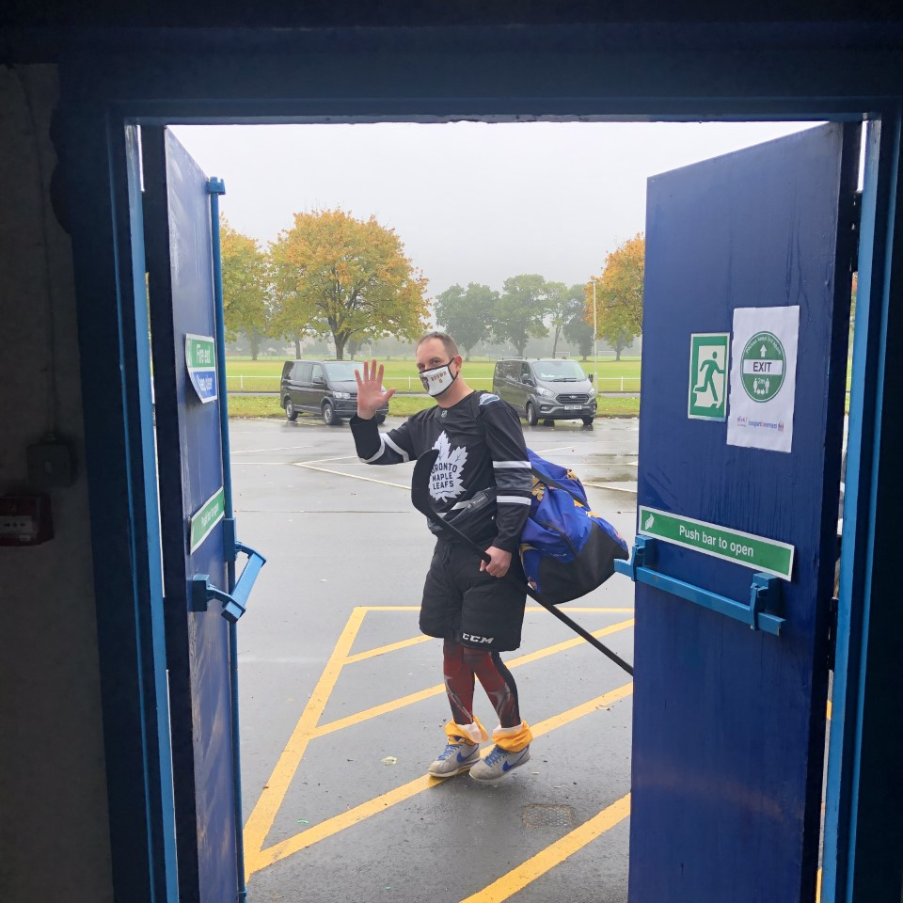
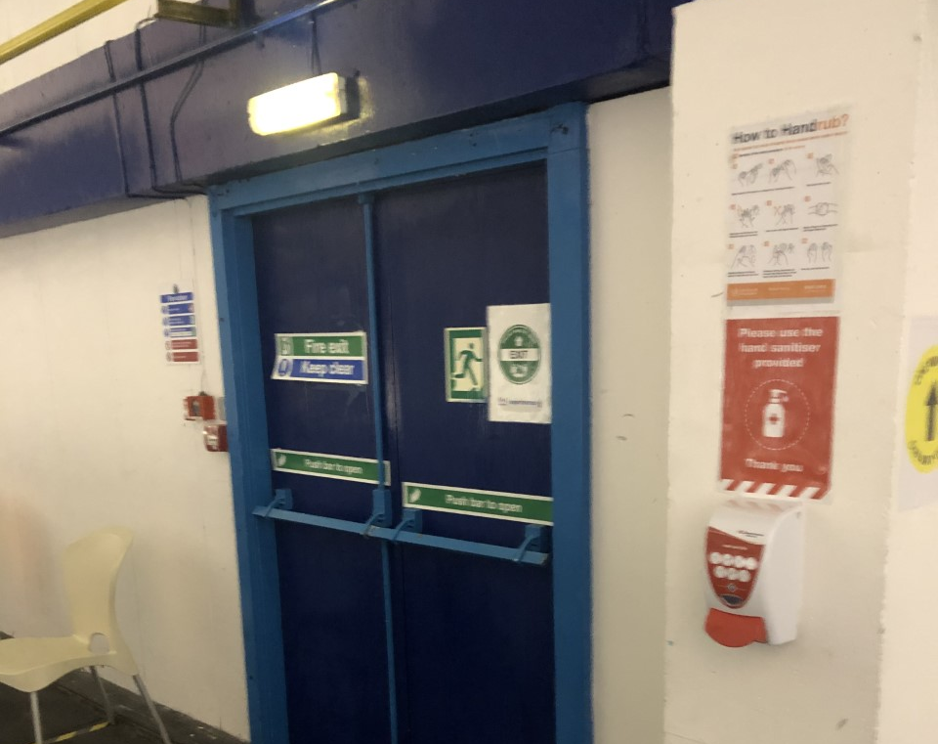

Exiting the Ice Hall
Please exit by the allocated exit on the Car park side as directed
Please use the Sanitizer as you leave
Stay Safe and we hope to see you soon for your next session!

